Slide 1
Recursion
CS 201, Summer 2013

Slide 2
ADDITIONAL READING
Recursion
  Chapter 13 of Pearson book
  http://www.cprogramming.com/tutorial/lesson16.html

Slide 3
What is a Recursive Function?
In the most general terms, it is a function that calls itself.
There is usually a Recursive Case – a condition where the function will call itself again,
And a Base Case – the ending condition that will cause the very last function called to return instead of calling itself again.

Slide 4
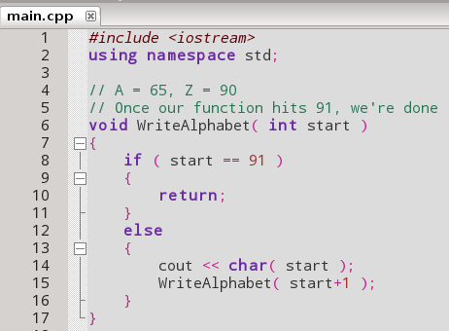
What is a Recursive Function?
Remember that we can represent the letter “A” as 65, and the letter “Z” as 90.
If we've passed the last letter, then return.
Otherwise, print the current value and call WriteAlphabet again to handle the next item in the list.

Slide 5
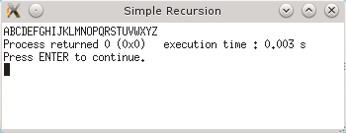
What is a Recursive Function?
Remember that we can represent the letter “A” as 65, and the letter “Z” as 90.

Slide 6
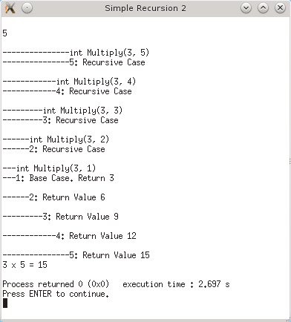
What is a Recursive Function?
Here's a function that indents its output based on which call it is on.
Can visually see the recursion as one function calls another, then step-by-step return
This recursive function finds the product of two numbers a * b using addition

Slide 7
What is a Recursive Function?
Multiply 4 * 2
Number = 4, times = 3
Multiply( 4, 3 )
Multiply( number, times )
Is times = 1?
No, call
Multiply( number, times-1 ) + number
Multiply( number, times )
Multiply( number, times )

Slide 8
What is a Recursive Function?
Multiply 4 * 2
Number = 4, times = 3
Multiply( 4, 3 )
Multiply( number, times )
Is times = 1?
No, call
Multiply( number, times-1 ) + number
Multiply( 4, 2 )
Multiply( number, times )
Is times = 1?
No, call
Multiply( number, times-1 ) + number
Multiply( number, times )

Slide 9
What is a Recursive Function?
Multiply 4 * 2
Number = 4, times = 3
Multiply( 4, 3 )
Multiply( number, times )
Is times = 1?
No, call
Multiply( number, times-1 ) + number
Multiply( 4, 2 )
Multiply( number, times )
Is times = 1?
No, call
Multiply( number, times-1 ) + number
Multiply( 4, 1 )
Multiply( number, times )
Is times = 1?
Yes, return number
number = 4

Slide 10
What is a Recursive Function?
Multiply 4 * 2
Number = 4, times = 3
Multiply( 4, 3 )
Multiply( number, times )
Is times = 1?
No, call
Multiply( number, times-1 ) + number
Multiply( 4, 2 )
Multiply( number, times )
Is times = 1?
No, call
Multiply( number, times-1 ) + number
return 4
Multiply( 4, 1 )
Multiply( number, times )
Is times = 1?
Yes, return number
number = 4

Slide 11
What is a Recursive Function?
Multiply 4 * 2
Number = 4, times = 3
Multiply( 4, 3 )
Multiply( number, times )
Is times = 1?
No, call
Multiply( number, times-1 ) + number
Received number 4,
New value is
return value + number
Multiply( 4, 2 )
Multiply( number, times )
4 + 4
Is times = 1?
No, call
Multiply( number, times-1 ) + number
return 4
Multiply( 4, 1 )
Multiply( number, times )
Is times = 1?
Yes, return number
number = 4

Slide 12
What is a Recursive Function?
Multiply 4 * 2
Number = 4, times = 3
Received number 8,
New value is
return value + number
Multiply( 4, 3 )
Multiply( number, times )
8 + 4
Is times = 1?
No, call
Multiply( number, times-1 ) + number
Received number 4,
New value is
return value + number
Multiply( 4, 2 )
Multiply( number, times )
4 + 4
Is times = 1?
No, call
Multiply( number, times-1 ) + number
return 4
Multiply( 4, 1 )
Multiply( number, times )
Is times = 1?
Yes, return number
number = 4

Slide 13
Recursive vs. Iterative
Recursion is a way to loop by having a function call itself; the function contains the work to be done each loop, as well as the ending case.
We can also use a while or for-loop to solve the same problems (called an Iterative approach).

Slide 14
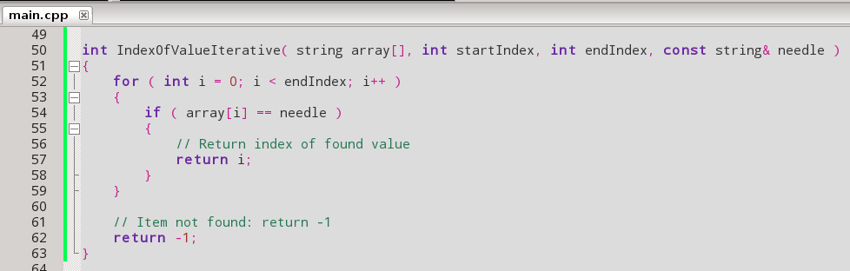
Recursive vs. Iterative
Here is a search function that finds the index of the thing being searched for

Slide 15
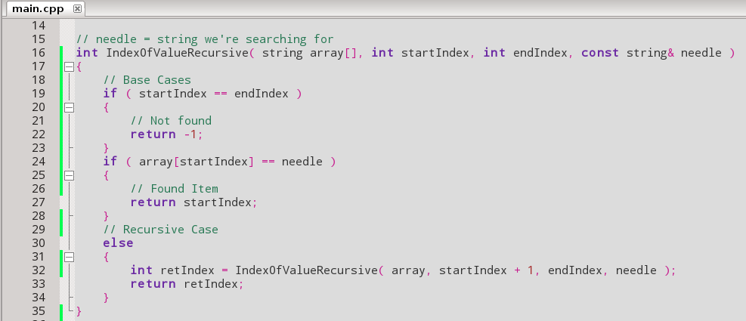
Recursive vs. Iterative
And a recursive version of the same thing.
In the Recursive case, if the element does not match we call
IndexOfValueRecursive(...) again, but we add one to the index.

Slide 16
Recursion
Recursion can be hard to wrap your head around, since it seems more 'natural' to think of things in an iterative way.
Recursion is useful for searching/sorting

Slide 17
Recursion and Math
Remember Series & Sequences?
5
i = 1
We can represent these recursively

Slide 18
Recursion and Math
5
i = 1
i from 1 to 5:
= (1 – 1) + (2 – 1) + (3 – 1) + (4 – 1) + (5 – 1) = 10

Slide 19
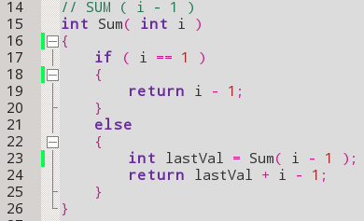
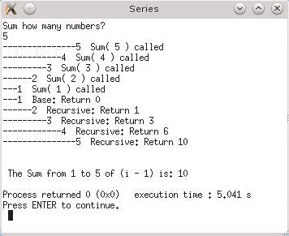
Recursion and Math
5
i = 1

Slide 20
Practice
Write a version of this function that uses Recursion instead of Iteration:
void TaxItem( float prices[], int size )
{
for ( int i = 0; i < size; i++ )
{
prices[i] = prices[i] + ( prices[ i ] * 0.8 );
}
}

Slide 21
Practice
Write a version of this function that uses Recursion instead of Iteration:
int FindItem( string names[], string findMe, int start, int end )
{
for ( int i = start; i < end; i++ )
{
if ( names[ i ] == findMe )
{
return i;
}
}
return -1;
}

Slide 22
Practice
Write a recursive function that generates the value of n! (n-factorial)

Slide 23
References

